Slide 1

Combined Kalman Filter and Siamese Network for Real-Time Visual Tracking
Liming Gao, Chengyu Hu, Zekai Liu, Mingzhao Yu
Group 12
The Pennsylvania State University
01 March 2020

Slide 2
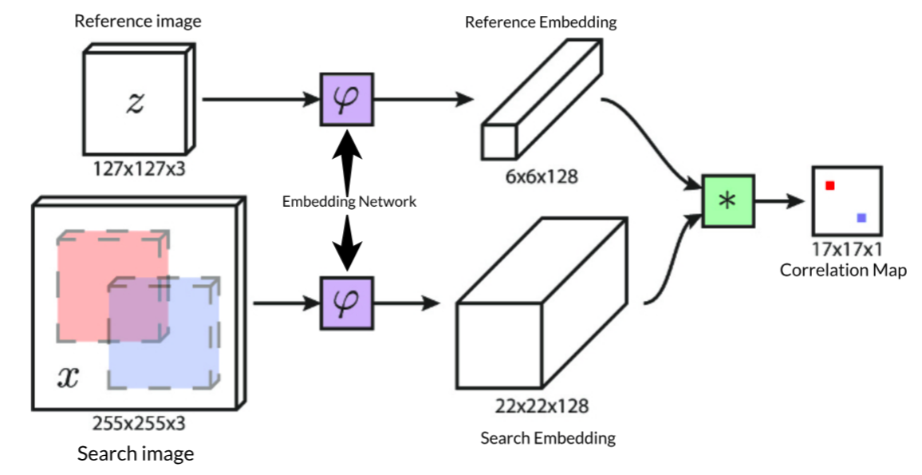
Problem: Occlusion
Siamese-FC
Only tracking offline to use limited training data to build a tracker
Uses the first frame target as the template for subsequent
Trackers highly rely on similarity scores to predict the target’s position
SiameseFC tracker
robots.ox.ac.uk

Slide 3
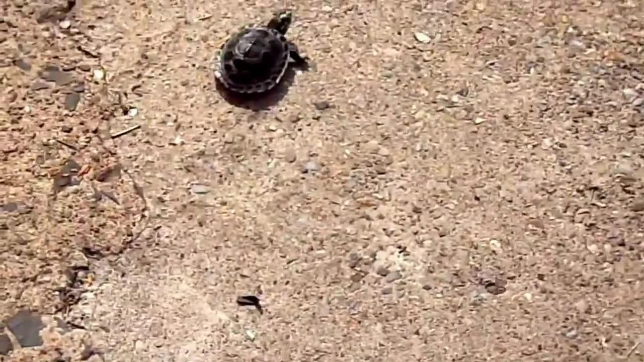
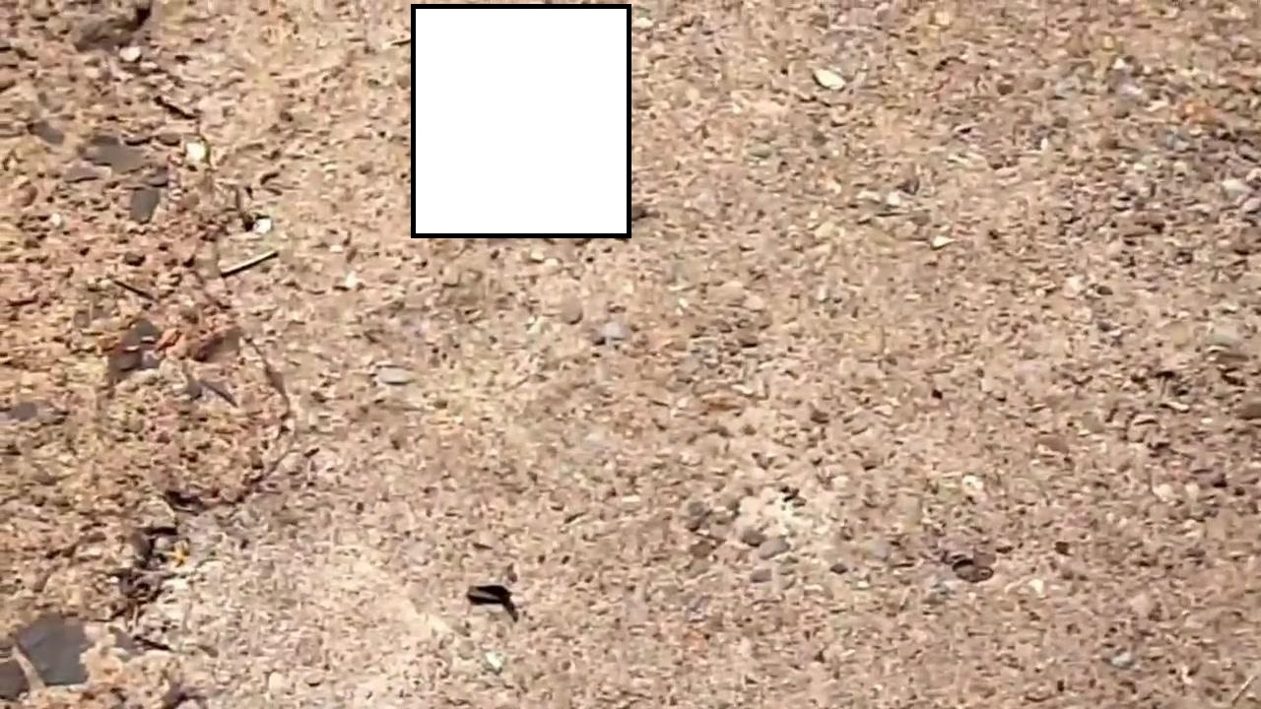
Dataset
Dataset
ILSVRC 2015
Test 1
Occlusion with Siam-FC
(Original CNN)
Test 2
Occlusion with Siam-FC
(With linear prediction)

Slide 4
Approach
Kalman filter
Obtain the target motion information
Combine it with the Siamese network for stable tracking
The motion information is used to resolve the occlusion of the target
and change the selection method of the search area during the tracking process
(x₁, y₁), (x₂, y₂),…,(x_{N}, y_{N} )
Positions of previous N bounding box
Gate: 0.5
If maximal<0.5
Maximal score in correlation map
If maximal>0.5
SiameseFC tracker
robots.ox.ac.uk
Kalman Filter-based Heuristic Ensemble: A New Perspective on ...
groundai.com

Slide 5
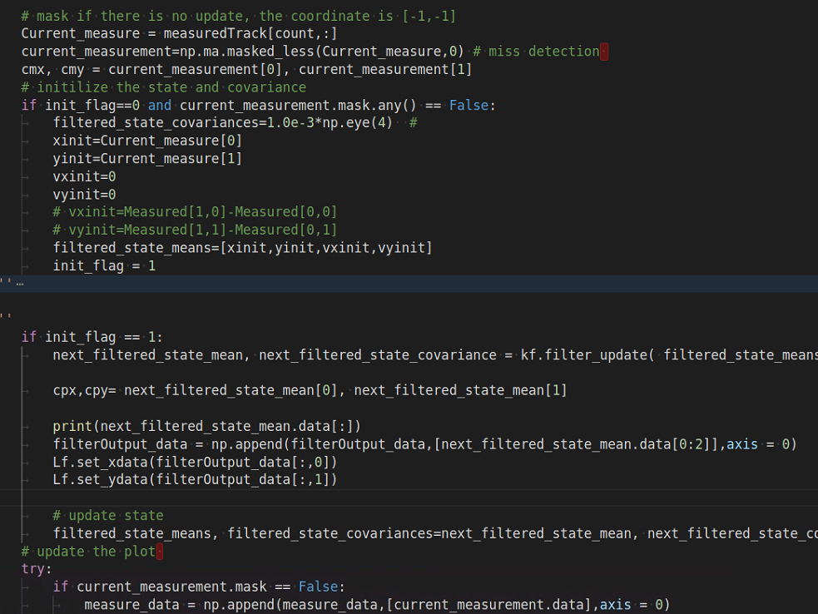
Kalman filter
Since neither observed value nor estimated value are perfectly reliable, we use Kalman filter to combine these two values and get a more rationable result.
Prediction and update
Partial Code

Slide 6
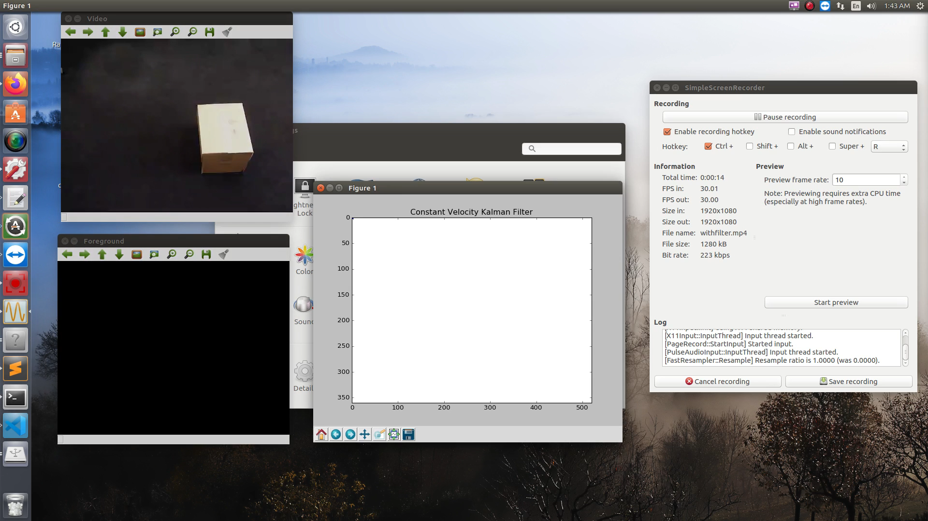
Kalman filter
Test
w/o Kalman filter
w/ Kalman filter

Slide 7
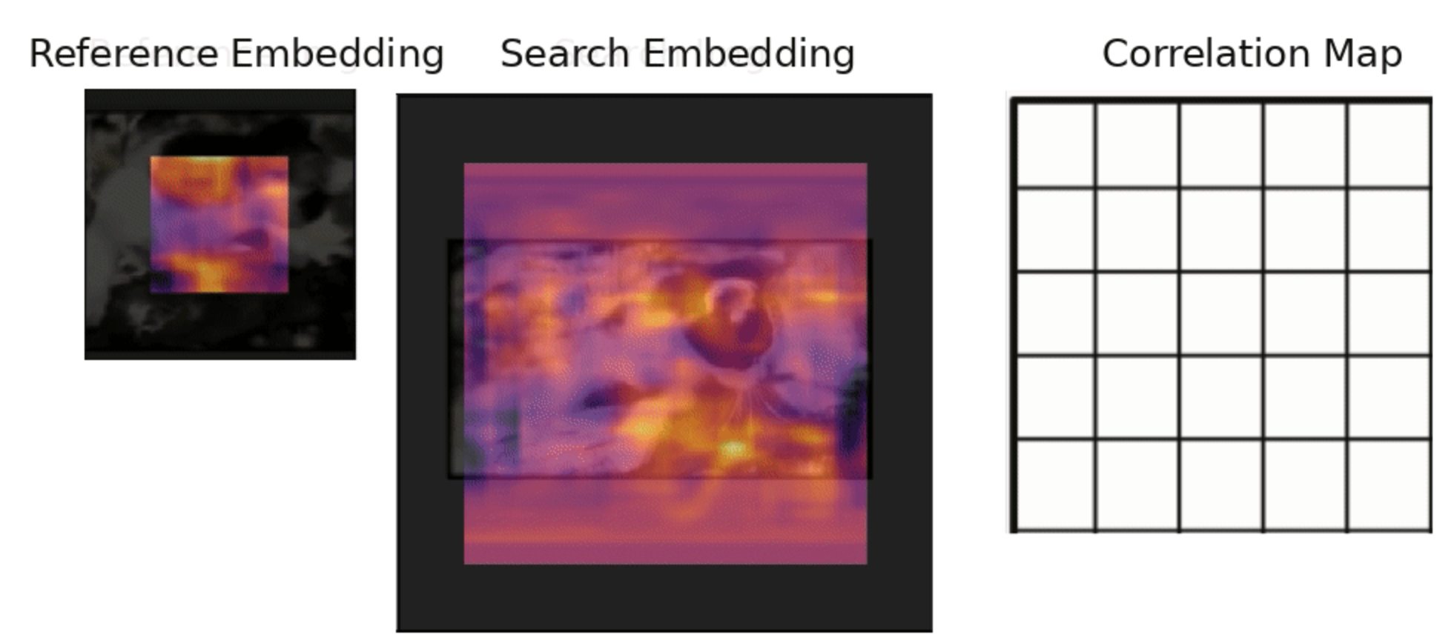
Preliminary Result
Kalman
1. Find the value of variances R, Q, W
2. The motion models(Transition matrix and control matrix) are difficult to determine
Siamese-FC
The Neural networks are slow to make predictions
Next Step
1. Crop large search images to small ones to shorten prediction time
2. Improve the Kalman filter algorithm to predict complex trajectories

